Slide 1
Tableau Reinforcement Project on Sports data
Presented by
Mohan babu m r
Da & ds

Slide 2
Dataset Overview
Tableau provides a suite of tools to transform raw sports data into interactive and insightful visualizations. These visualizations help in understanding player performances, team dynamics
Interactive Dashboards :Create dynamic dashboards that allow users to filter and drill down into specific data points.

Slide 3
Key Insights
Real-Time Data Integration: Connect to live data sources to monitor ongoing matches or events, providing up-to-date insights.
Explore Tableau's repository of sample data to practice creating visualizations

Slide 4
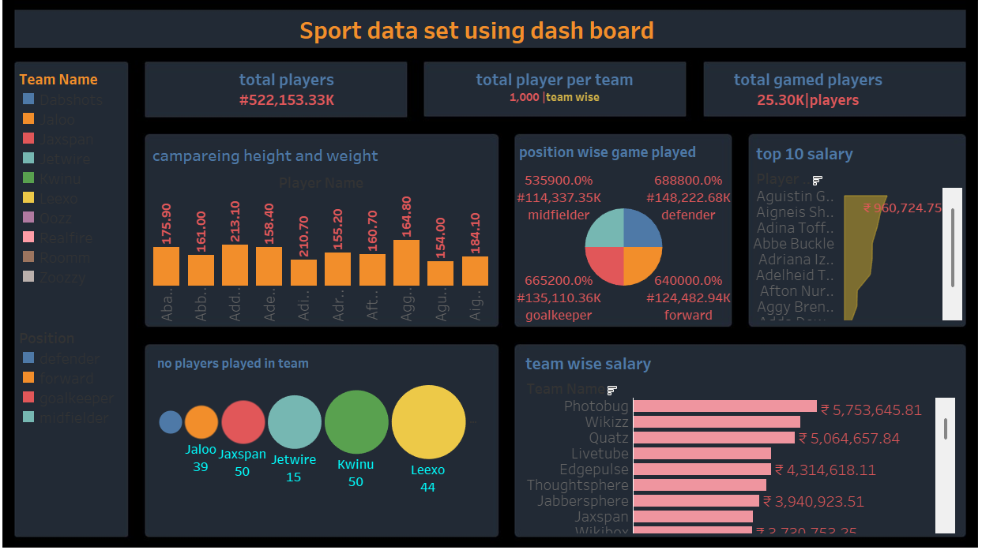

Slide 5
Conclusion
Tableau empowers sports organizations to transform complex datasets into actionable insights, enhancing performance analysis, fan engagement, and operational efficiency.
By leveraging interactive dashboards and real-time analytics, teams can make data-driven decisions that drive success both on and off the field.

Slide 6
Thank you

